Slide 1
Primary school registration

Slide 2
OVERVIEW
01
02
03
04
05
BACKGROUND
PROBLEM STATEMENT
DATA ANALYSIS
DATA MODELLING
FINDINGS
Current situation
Issue faced by parents
What the data shows
Model results
Recommendations

Slide 3

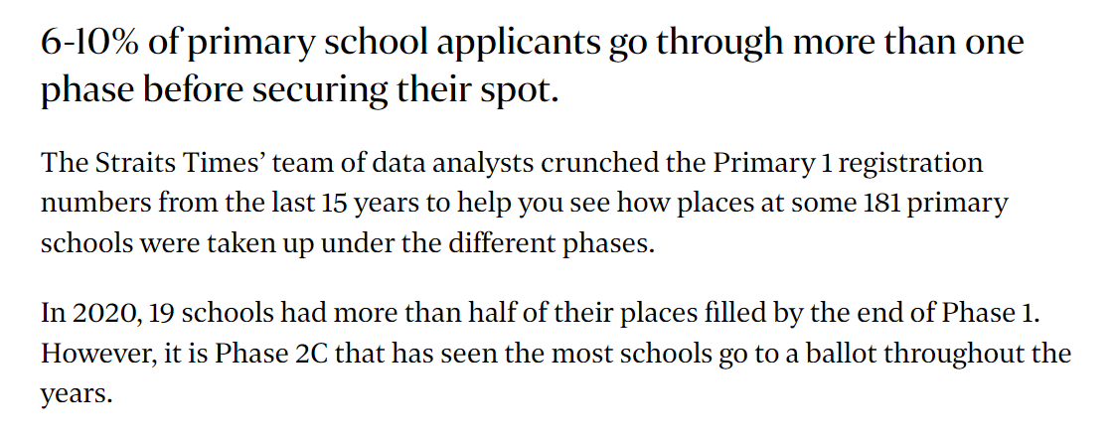
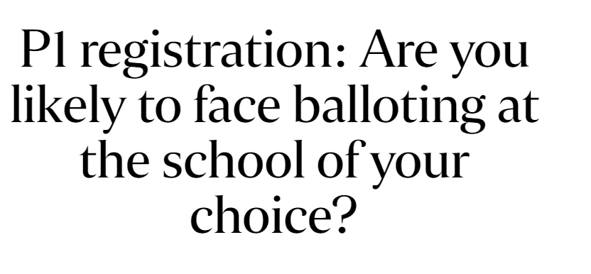
BACKGROUND

Slide 4
BACKGROUND
Parent submit Nanyang Primary School as school of choice
Found out that Nanyang Primary School has more applicants than vacancies
Continue with application to Nanyang Primary School
Apply for another school
Posted to Nanyang Primary
Registration opens
Not allocated a school in this phase

Slide 5
Problem statement
What are some similar schools that parents can apply for if they want to change their choice of school?

Slide 6
18123
15111
Total vacancies across all schools
Total applicants across all schools

Slide 7
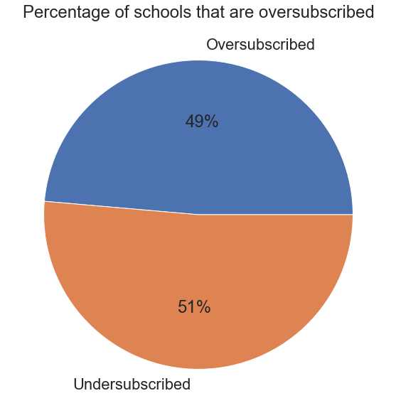
DATA ANALYSIS
88/181 schools are oversubscribed (Vacancies < Applicants)

Slide 8
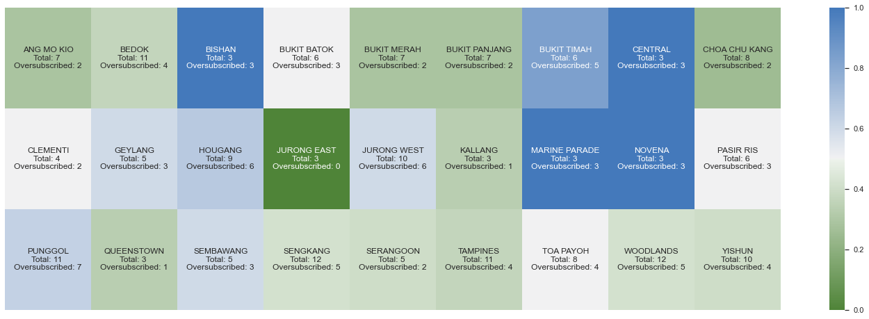
DATA ANALYSIS

Slide 9
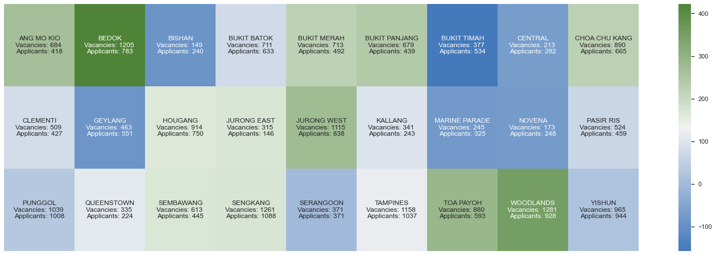
DATA ANALYSIS

Slide 10
DATA ANALYSIS
This suggests that parents have been consciously choosing oversubscribed schools, even though there are vacancies in nearby schools

Slide 11
DATA ANALYSIS
Government-aided schools
Special Assistance Plan (SAP)
Schools that are set up by various community organisations to cater to the educational needs of their respective communities
Schools that have additional programmes
to nurture bilingual leaders of the future
Attributes of schools
Gifted Education Programme (GEP)
Co-curricular Activities (CCA)
For students that have been identified as intellectually gifted – to prepare them for leadership and service to country
Activities that students can participate in – Sports, Arts, Uniformed groups.
Excellence in these activities may allow the student direct admission into their preferred Secondary School.

Slide 12
HYPOTHESIS
As long as the school offers good programmes and activities, the nature/type of school may not be a feature that parents prioritise

Slide 13
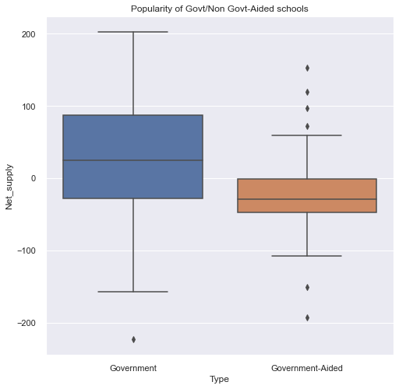
DATA ANALYSIS
There is a preference for Government-Aided schools

Slide 14
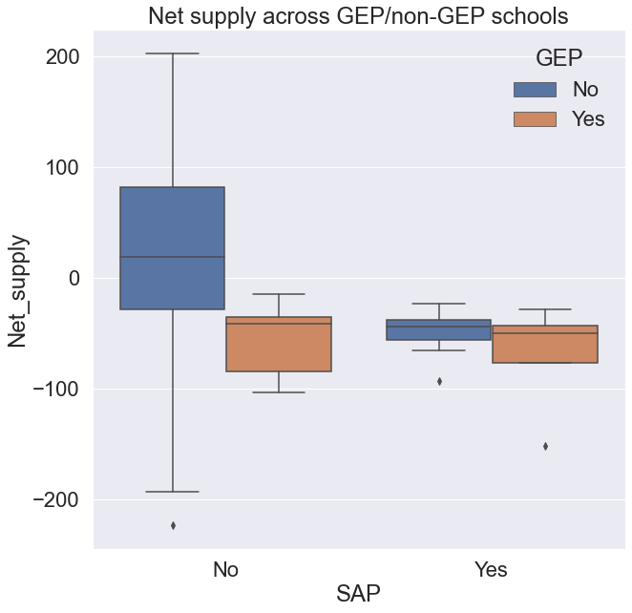
DATA ANALYSIS
Parents prefer schools with better programmes
But they do not seem to have a particular preference for the GEP, as long as the school has SAP programme

Slide 15
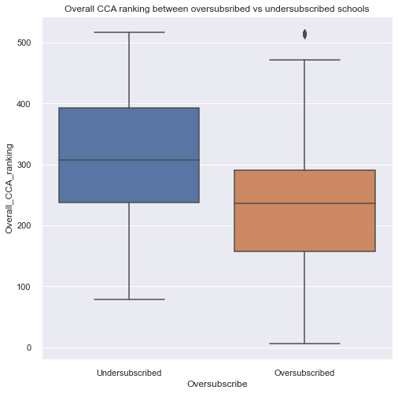
DATA ANALYSIS
There is a preference for schools with better CCA

Slide 16
Problem statement
What are some similar schools that parents can apply for if they want to change their choice of school?

Slide 17
DATA MODELLING
 | Number of clusters | Silhouette score
K means clustering | 3 | 0.78
Hierarchical clustering | 2 | 0.72

Slide 18
RESULTS
1
2
3
Schools that have strong programmes and activities
Schools that do well in certain aspects, such as CCA
Schools that are generalist in nature

Slide 19
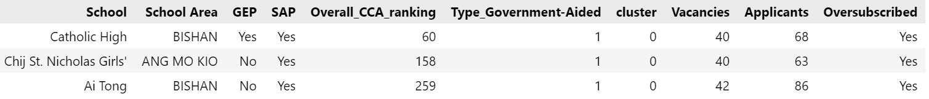
FINDINGS
1
Parent A who aims to enter a top school, and is looking at increasing his chance of securing a place in a similar school

Slide 20
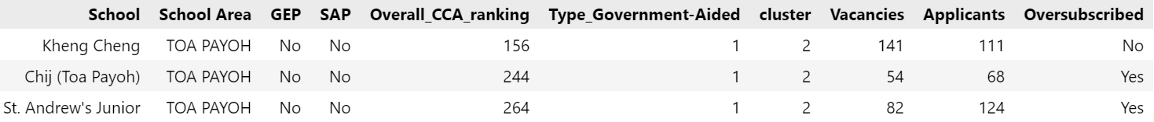
FINDINGS
2
Parent B who is keen on schools which are good in certain aspects such as CCA, and are trying to avoid balloting

Slide 21
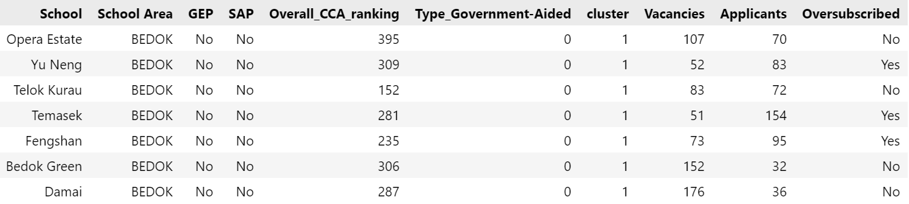
FINDINGS
3
Parent C who has no strong preference for activities and programmes, and are looking for backup plans

Slide 22
FUTURE PERSPECTIVE
Extend this study with historical data on balloting results and birth rates. Hypothesis: Birth rate varies with Zodiac signs, which may affect balloting results (E.g. It may be more difficult to secure an ideal school for Dragon babies)

Slide 23
APPENDIX

Slide 24
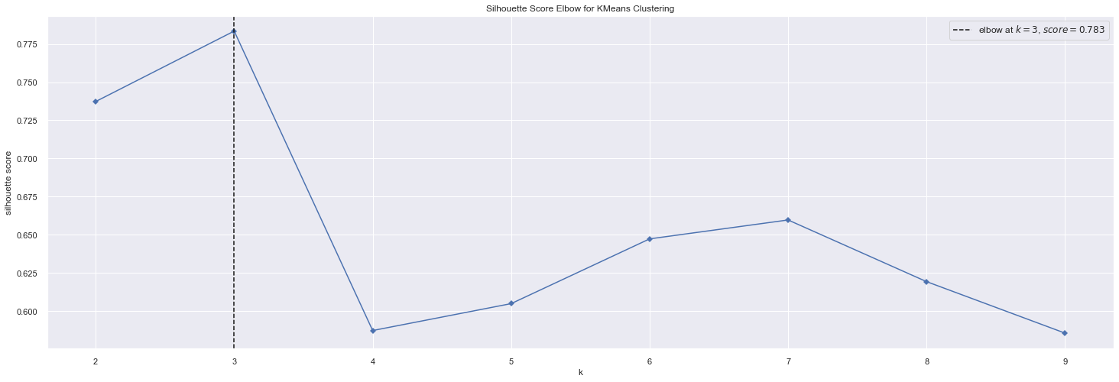
DATA MODELLING
Number of clusters: 3
Silhouette score: 0.78

Slide 25
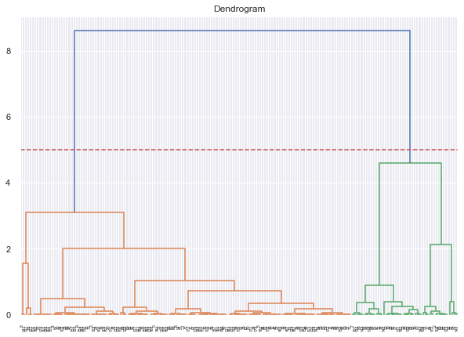
DATA MODELLING
Number of clusters: 2
Silhouette score: 0.72

